Slide 1
Math Project Group-A
Made by members of Group A, a project on brick price estimation.

Slide 2
To do:
Find total price of the amount of bricks used in the new building of KMGSS Sector 2, including only the classrooms, washrooms and stairway walls.

Slide 3
Method:
In order to find the total cost of the bricks used in such building, the total volume of walls in the building excluding doors, windows, floor and ceiling are divided by the volume of a single brick. After finding the number of bricks, the price of RS.13 per brick is to be calculated to find the total cost.

Slide 4



Visualize:
CLASS ROOM
WASH ROOMS
STAIR WAY

Slide 5
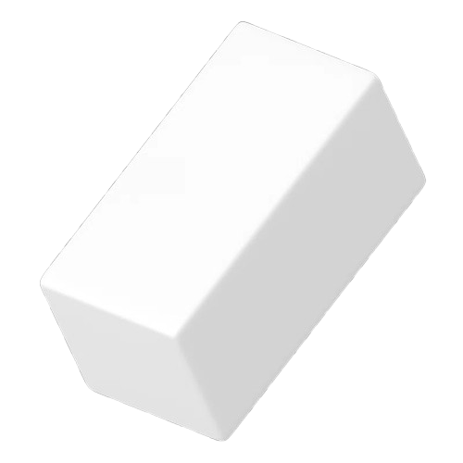
BRICK:
Measurements:
Length:21cm = 0.7ft
Breadth:6cm = 0.2ft
Height:10cm = 0.3ft
=> VOLUME = 0.042ft3

Slide 6
CLASS ROOM:
Measurements:
Length:28ft
Breadth:18ft
Height:10ft
Thickness of Wall:1ft
Length of window:9ft
Breadth of window:6ft
Length of door:7ft
Breadth of door:3ft
Volume of all Walls where there are 2 length side wall and 2 breadth side wall:
= 920ft3
Total volume of walls excluding doors and windows:
791ft3

Slide 7
WASH ROOM:
Measurements:
Length:28ft
Breadth:18ft
Height:10ft
Thickness of Wall:1ft
Length of doors:7ft
Breadth of doors:3ft
Volume of all Walls where there are 2 length side wall and 2 breadth side wall:
= 1100ft3
Total volume of walls excluding doors:
= 1058ft3

Slide 8
STAIR WAY:
Measurements:
Length:28ft
Breadth:18ft
Height:10ft
Thickness of Wall:1ft
Length of ventilation:9ft
Breadth of ventilation:3ft
Volume of all Walls where there are 2 length side wall and 2 breadth side wall:
= 640ft3
Total volume of walls excluding ventilation
= 613ft3

Slide 9
Total volume:
VOLUME OF CLASSROOM = 791ft3
SINCE there are 20 classrooms, 4 washrooms, and 4 stairways in the building,
VOLUME OF WAHROOM = 1058ft3
TOTAL VOLUME = 20*719 + 4*(1058+613)
= 25504ft3 #
VOLUME OF STAIRWAY = 613ft3

Slide 10
NUMBER OF BRICKS:
TOTAL NUMBER OF BRICKS = (25504 / 0.042)ft3
= 535810 (approx)

Slide 11
TOTAL COST:
Since 1 brick costs RS13, Price of bricks is number of bricks * rs13
= 535810 * 13
= RS 6965530 approx

